Slide 1
THROID HEALTH ANALYZER USING XAI
S.RAKESH KUMAR(811721104083)
S.VALLIYAPPAN(81172104117)
M.MOHAMMED HUSSAIN(811721104302)

Slide 2
Domain Introduction
Image processing involves transforming or interpreting an image to improve its quality or extract valuable insights.
It’s part of signal processing where an image serves as input, and the output could be either a modified image or specific data (like features or attributes) extracted from it.
As a crucial research area within engineering and computer science, image processing has widespread applications in fields like healthcare, surveillance, robotics, and more. The fundamental stages in image processing include:
1. Image Acquisition
2.Image Analysis and Manipulation
3. Output Generation

Slide 3
Abstract
This study introduces a novel framework for thyroid health analysis, using Convolutional Neural Networks (CNN) enhanced with Explainable Artificial Intelligence (XAI) techniques for thyroid condition classification from medical images.
The framework leverages CNNs to achieve high accuracy in differentiating thyroid conditions, showcasing strong performance in medical image classification.
XAI integration provides transparency, offering interpretable insights into the model’s decision-making process, which supports clinicians in understanding the model’s predictions.
The framework extends beyond classification by recommending specialized healthcare providers based on the detected thyroid condition, offering actionable guidance.

Slide 4
Objectives
Predict Thyroid Condition: Classify input images to determine if they indicate thyroid abnormalities.
Implement Deep Learning Models: Apply various deep learning algorithms for improved thyroid classification.
Optimize Classification Performance: Enhance accuracy and efficiency of the classification algorithms.
Provide Practical Recommendations: Suggest suitable doctors and display a list of relevant medicines based on the diagnosis.

Slide 5
Introduction
The integration of artificial intelligence (AI) into healthcare has revolutionized the approach to disease diagnosis and treatment, with medical imaging emerging as a particularly promising area.
Given the exponential increase in digital medical imaging data, there is a critical need for effective AI-based tools to derive meaningful insights, supporting clinicians in making accurate diagnoses and informed treatment plans
The development of a Thyroid Health Analyzer using Explainable Artificial Intelligence (XAI) combines the power of advanced AI techniques with interpretability, enhancing diagnostic accuracy while providing transparent insights for clinicians.
This approach supports a more accessible and trustworthy analysis of thyroid health, making AI-driven medical imaging a vital tool in modern healthcare.

Slide 6
Existing system
In existing system, while traditional methods for diagnosing thyroid disorders have served as the cornerstone of clinical practice for decades, they are not without limitations.
These methods often rely on subjective interpretation, leading to variability in diagnosis and treatment decisions.
Moreover, the increasing complexity and volume of medical imaging data present challenges for clinicians, highlighting the need for automated and efficient diagnostic solutions.
One of the primary challenges associated with deep learning models, including CNNs, is their black-box nature.
While these models may achieve high accuracy in classification tasks, understanding the rationale behind their predictions remains challenging

Slide 7
Disadvantages
Limited Efficiency with Large Datasets
Inconsistent Prediction Accuracy
High Time Consumption

Slide 8
Proposed system
In proposed system, the input image is taken from dataset repository. In pre-processing, we can resize the original image and gray scale conversion.
After that, we can extract the features from pre-processed image such as LBP and Mean Median Variance.
We can split the images into test image and train image. Then, we can implement the different deep learning algorithms such as Convolutional Neural Network (CNN) for classifying the input image is affected or not.
Finally, the system can estimate some performance metrics such as accuracy and error rate.
The effectiveness of the proposed method was confirmed by comparing accuracy improvement.

Slide 9
Advantages
Accurate Thyroid Condition Classification
Enhanced Transparency with Explainable AI
Insightful Visualizations for Clinician Support
Personalized Doctor and Medication Recommendations
Improved Diagnostic Confidence and Trust

Slide 10
Block Diagram
PREPROCESSING
FEATURE EXTRACTION
IMAGE SPLITTING
INPUT IMAGE
PREDICTION
PERFORMANCE ANALYSIS
CLASSIFICATION

Slide 11
Block Diagram
Thyroid Image Dataset
PREPROCESSING
Image Resize
Gray Scale Conversion
LBP
FEATURE EXTRACTION
Mean, Median, Variance
Test Image
IMAGE SPLITTING
Train Image
Deep Learning
CNN
CLASSIFICATION
Accuracy
Error rate
Recommendations
Affected or not
PERFORMANCE ANALYSIS
View Medicines

Slide 12
Modules
Image selection
Image preprocessing
Feature extraction
Image Splitting
Classification
Prediction
Performance Analysis

Slide 13
Image Selection
The dataset, thyroid disease dataset is implemented as input. The dataset is taken from dataset repository. The input dataset is in the format ‘.png, ‘.jpg.
In this step, we have to read or load the input image by using the imread () function.
In our process, we are used the kinter file dialogue box for selecting the input image.

Slide 14
Preprocessing
In our process, we have to resize the image and convert the image into gray scale.
To resize an image, you call the resize () method on it, passing in a two-integer tuple argument representing the width and height of the resized image.
The function doesn't modify the used image; it instead returns another Image with the new dimensions.
Convert an Image to Grayscale in Python Using the Conversion Formula and the matplotlib Library.
We can also convert an image to grayscale using the standard RGB to grayscale conversion formula that is imgGray = 0.2989 * R + 0.5870 * G + 0.1140 * B.

Slide 15
Feature Extraction
In our process, we have to extract the features from pre-processed image.
Standard deviation is the spread of a group of numbers from the mean.
The variance measures the average degree to which each point differs from the mean.
Local Binary Pattern (LBP) is an effective texture descriptor for images which thresholds the neighboring pixels based on the value of the current pixel .
LBP descriptors efficiently capture the local spatial patterns and the gray scale contrast in an image.

Slide 16
Image splitting
During the machine learning process, data are needed so that learning can take place.
In addition to the data required for training, test data are needed to evaluate the performance of the algorithm in order to see how well it works.
In our process, we considered 70% of the input dataset to be the training data and the remaining 30% to be the testing data.
Data splitting is the act of partitioning available data into two portions, usually for cross-validator purposes.

Slide 17
Classification
In our process, we can implement the deep learning algorithm such as CNN-2D.
A CNN is a kind of network architecture for deep learning algorithms and is specifically used for image recognition and tasks that involve the processing of pixel data.
There are other types of neural networks in deep learning, but for identifying and recognizing objects, CNNs are the network architecture of choice.
The CNN-2D architecture, or Convolutional Neural Network 2D, is a specialized type of deep learning architecture designed specifically for processing two-dimensional data, such as images.
The CNN-2D architecture typically consists of multiple layers, including convolutional layers, pooling layers, and fully connected layers

Slide 18
Performance metrics
The Final Result will get generated based on the overall classification and prediction. The performance of this proposed approach is evaluated using some measures like,
Accuracy
Accuracy of classifier refers to the ability of classifier. It predicts the class label correctly and the accuracy of the predictor refers to how well a given predictor can guess the value of predicted attribute for a new data.
AC= (TP+TN)/ (TP+TN+FP+FN)
Then, we can detect or to classify the input image is affected by thyroid or not.

Slide 19
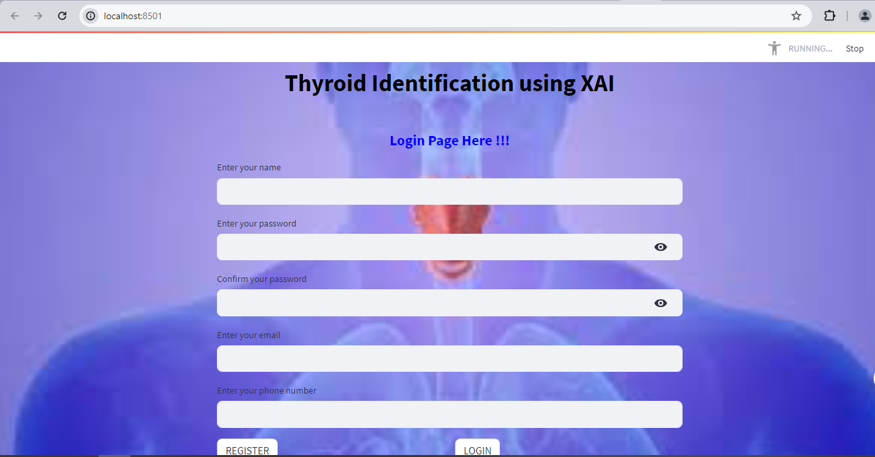
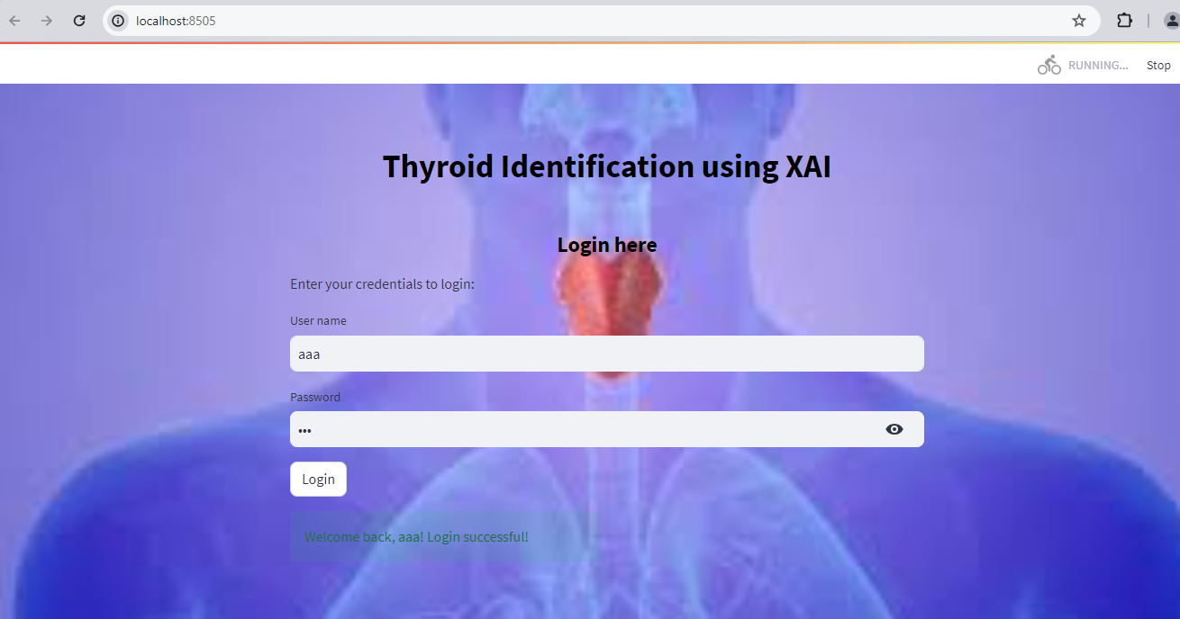
Screenshots

Slide 20
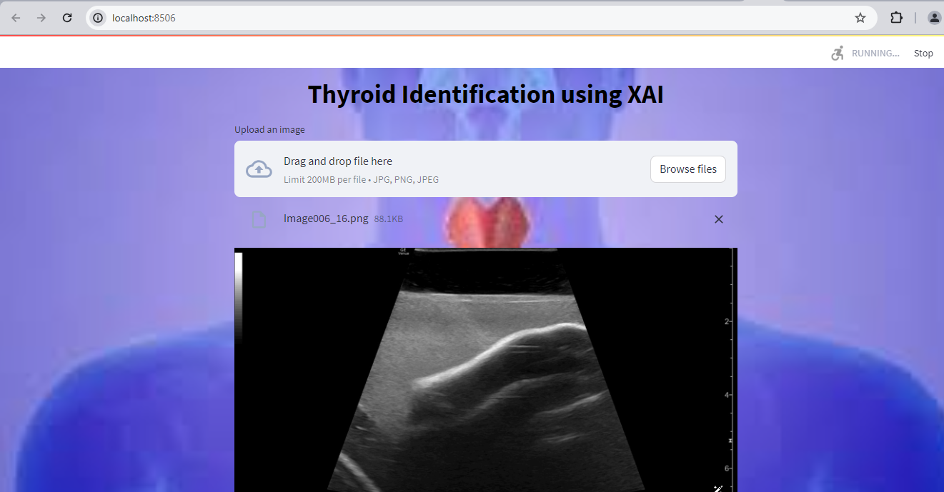
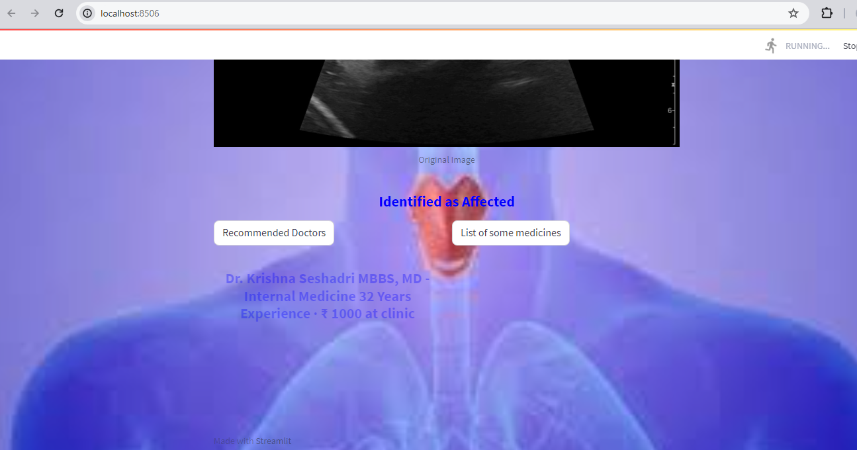
Screenshots

Slide 21
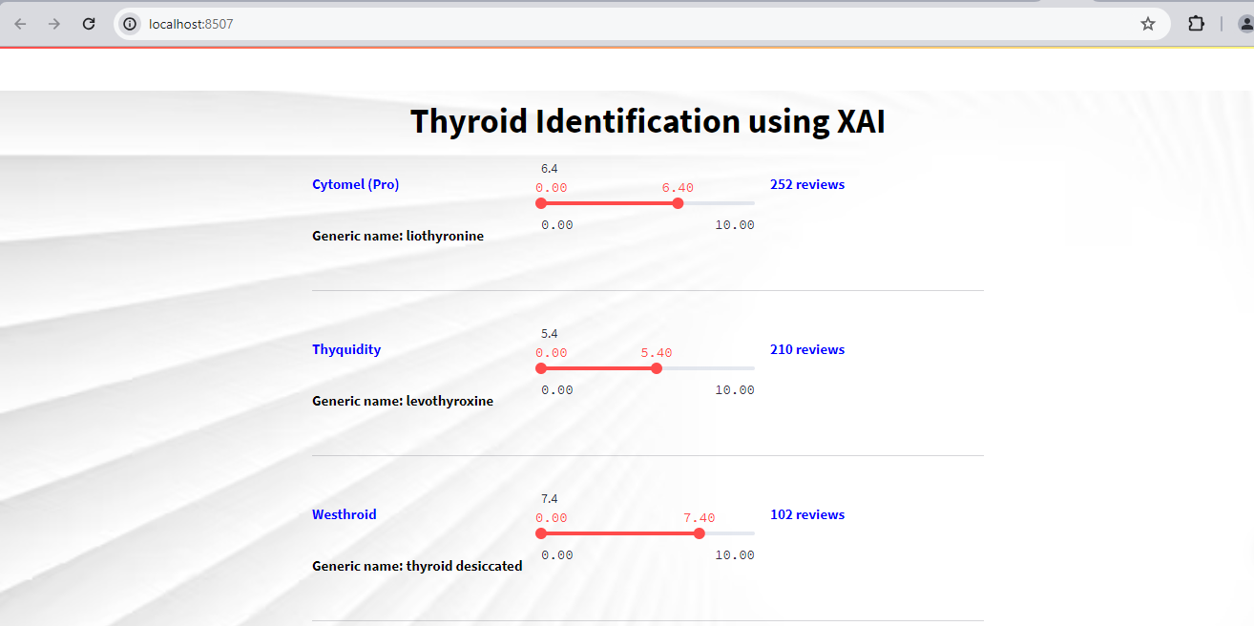
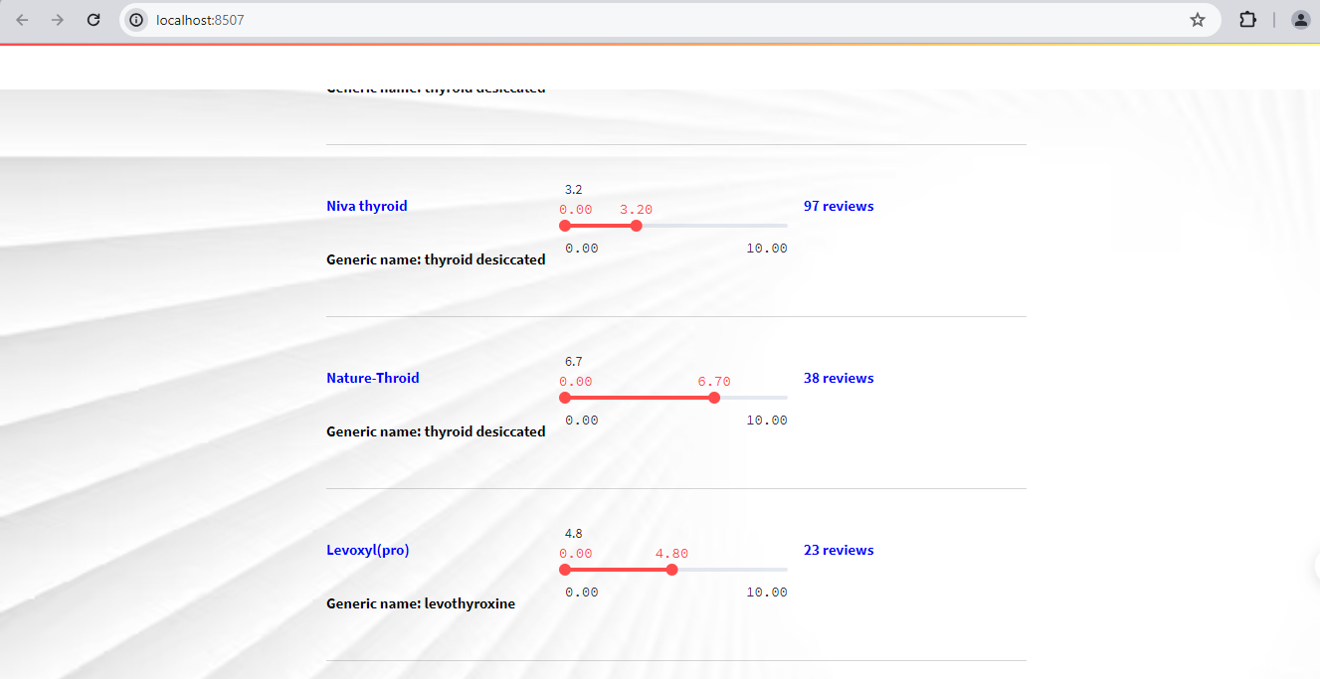
Screenshots

Slide 22
Literature survey

Slide 23
Title | Year | Author | Methodology | Merits/demerits
Thyroid Disease Detection Using Convolutional Neural Networks: A Comparative Study | 2020 | Smith, J., et al. | The authors utilized a diverse dataset comprising thyroid ultrasound images and employed various CNN architectures, including VGG, ResNet, and Inception, to extract features and classify thyroid conditions. | The study offers a comprehensive comparison of CNN architectures for thyroid disease detection, providing valuable insights into their relative performance and suitability for clinical applications. By leveraging a diverse dataset, the authors ensure the robustness and generalizability of their findings, thereby contributing to the advancement of automated thyroid disease diagnosis.

Slide 24
Title | Year | Author | Methodology | Merits/demerits
Interpretable Thyroid Nodule Classification Using Deep Learning and Attention Mechanism | 2021 | Praveen Kumar Maduri; Shalu; Shobhit Agrawal; Alok Rai; Shubham Chaubey | This research proposes an interpretable deep learning framework for thyroid nodule classification, integrating CNNs with attention mechanisms to enhance model interpretability. The authors leverage a dataset of thyroid ultrasound images and employ a dual-path CNN architecture with attention mechanisms to highlight salient regions within the images. | The study addresses the critical issue of model interpretability in thyroid nodule classification, offering a novel approach that combines deep learning with attention mechanisms. By highlighting relevant regions within the images, the proposed framework enhances transparency and trust in the diagnostic process, thereby facilitating collaboration between AI systems and healthcare providers.

Slide 25
Title | Year | Author | Methodology | Merits/demerits
A Hybrid Deep Learning Approach for Thyroid Nodule Classification with Explainable AI | 2019 | Gupta, S., et al. | This study presents a hybrid deep learning approach for thyroid nodule classification, combining CNNs with eXplainable AI (XAI) techniques to enhance model interpretability. The authors leverage a dataset of thyroid ultrasound images and employ a CNN architecture to extract features, which are subsequently interpreted using XAI techniques such as Grad-CAM and SHAP. | The study offers a comprehensive approach to thyroid nodule classification, integrating deep learning with XAI techniques to enhance both accuracy and interpretability. By elucidating the features contributing to the model's predictions, the proposed approach enhances trust and transparency in the diagnostic process, facilitating informed decision-making by healthcare providers.

Slide 26
Title | Year | Author | Methodology | Merits/demerits
Thyroid Nodule Classification Using Deep Learning: A Review | 2022 | Patel, R., et al. | This review paper provides an overview of recent advancements in thyroid nodule classification using deep learning techniques. The authors survey a wide range of studies in the literature and categorize them based on the deep learning architectures employed, dataset characteristics, and evaluation methodologies. | The review offers a comprehensive synthesis of the existing literature on thyroid nodule classification using deep learning, providing valuable insights into the state-of-the-art approaches and trends in the field. By categorizing and analyzing the methodologies and findings of various studies, the authors facilitate a deeper understanding of the challenges and opportunities in automated thyroid nodule classification.

Slide 27
Title | Year | Author | Methodology | Merits/demerits
Explainable Deep Learning for Thyroid Nodule Classification: A Survey | 2006 | Wang, Y., et al. | This survey paper provides an in-depth exploration of explainable deep learning techniques for thyroid nodule classification. The authors review existing literature on explainable deep learning methods, including feature visualization, attention mechanisms, and gradient-based attribution methods, and evaluate their applicability in the context of thyroid nodule classification | The survey offers a comprehensive overview of explainable deep learning techniques for thyroid nodule classification, providing valuable insights into the state-of-the-art methods and their applicability in clinical practice.

Slide 28
System requirements
SOFTWARE REQUIREMENTS:
O/S : Windows 7.
Language : Python
Software used : Anaconda Navigator – Spyder IDE
Front end / framework: Streamlit
HARDWARE REQUIREMENTS:
System : Pentium IV 2.4 GHz
Hard Disk : 200 GB
Ram : 4GB

Slide 29
Conclusion
We conclude that, the thyroid image dataset was collected from dataset repository as input. The input dataset was mentioned in our research paper.
We are implemented the different classification algorithms (i.e.) deep learning algorithms. Then, deep learning algorithms such as Convolutional Neural Network (CNN-2D).
Finally, the result shows that the accuracy and error rate for above mentioned algorithm and predict the malaria is affected by thyroid disease or not.
Then, the system can recommend the doctors and view the list of medicines.

Slide 30
Future Enhancement
In the future, we should like to hybrid the two different deep or machine learning algorithms.
In future, it is possible to provide extensions or modifications to the proposed clustering and classification algorithms to achieve further increased performance.
Apart from the experimented combination of data mining techniques, further combinations and other clustering algorithms can be used to improve the detection accuracy.

Slide 31
References
1) LeCun, Y., Bottou, L., Bengio, Y., & Haffner, P. (1998). Gradient-based learning applied to document recognition. Proceedings of the IEEE, 86(11), 2278-2324.
2) Krizhevsky, A., Sutskever, I., & Hinton, G. E. (2012). ImageNet classification with deep convolutional neural networks. Advances in neural information processing systems, 25, 1097-1105.
3) Szegedy, C., Liu, W., Jia, Y., Sermanet, P., Reed, S., Anguelov, D., ... & Rabinovich, A. (2015). Going deeper with convolutions. In Proceedings of the IEEE conference on computer vision and pattern recognition (pp. 1-9).
4) Simonyan, K., & Zisserman, A. (2014). Very deep convolutional networks for large-scale image recognition. arXiv preprint arXiv:1409.1556.
5) He, K., Zhang, X., Ren, S., & Sun, J. (2016). Deep residual learning for image recognition. In Proceedings of the IEEE conference on computer vision and pattern recognition (pp. 770-778).

Slide 32
THANK YOU !!!

